Slide 1


Slide 2
Presentation on :- Transmisson Media
Presented by:-
Rupak parajuli
Roll no :- 21(twenty-one)

Slide 3
Table of content
About Transmission Media.
Types of Transmisson media
Satellite communication .…..

Slide 4
Transmisson media :-
Transmission media is a communication channel that carries the information from the sender to the receiver. Data is transmitted through the electromagnetic signals. It is a physical path between transmitter and receiver in data communication.
Different transmission media have different properties such as bandwidth, delay, cost and ease of installation and maintenance.

Slide 5
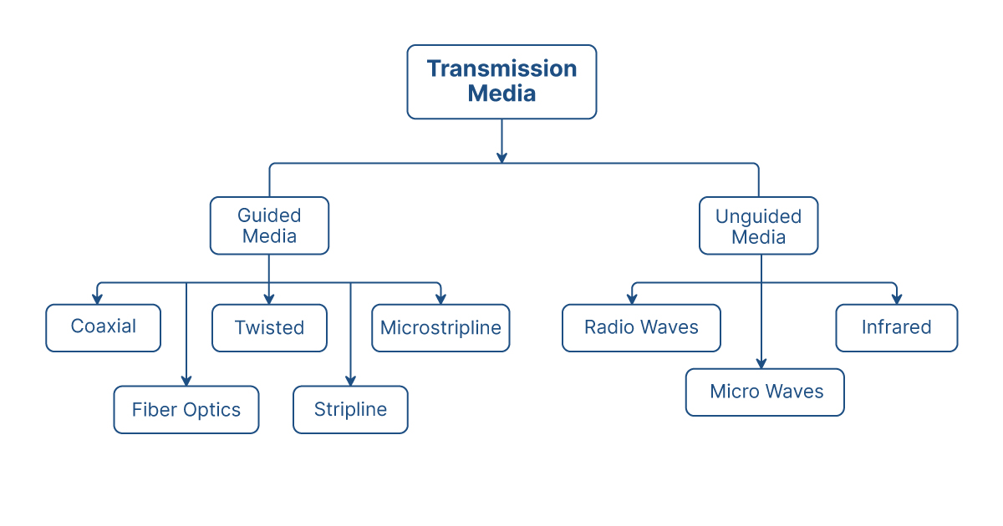
Types of transmission media :-

Slide 6
What is Satellite Communication?
Satellite communication is transporting information from one place to another using a communication satellite in orbit around the Earth. A communication satellite is an artificial satellite that transmits the signal via a transponder by creating a channel between the transmitter and the receiver at different Earth locations.
Telephone, radio, television, internet, and military applications use satellite communications . More than 2000 artificial satellites are hurtling around in space above your heads.

Slide 7
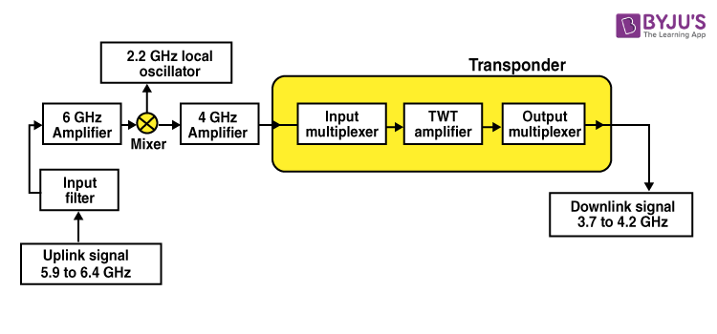
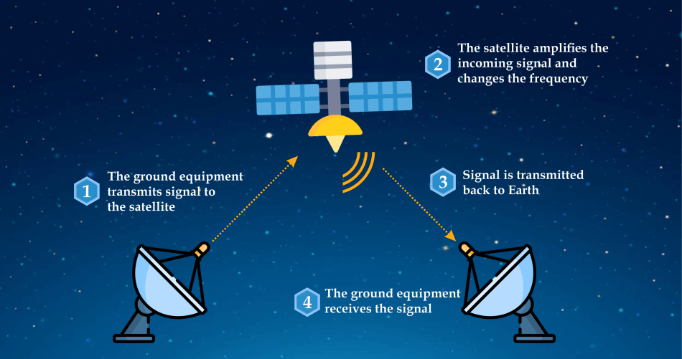

Slide 8
How Satellite Communications Work?
The communication satellites are similar to the space mirrors that help us bounce signals such as radio, internet data, and television from one side of the earth to another. Three stages are involved, which explain the working of satellite communications. These are:-
1.Uplink
2.Transponders
3.Downlink

Slide 9
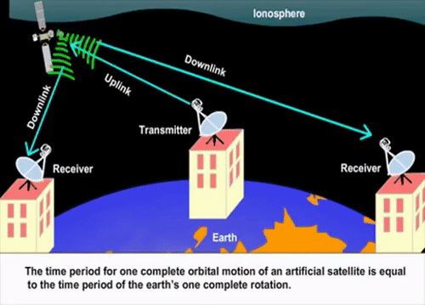
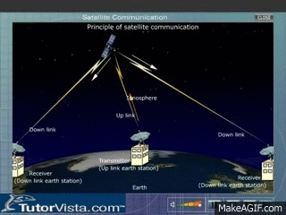

Slide 10
Need for Satellite Communication
We know that there are different ways to communicate, and the propagation of these waves can occur in different ways. Ground wave propagation and skywave propagation are the two ways communication takes place for a certain distance. The maximum distance covered by them is 1500 km, which was overcome by the introduction of satellite communication.

Slide 11
Satellite Communication Services
There are two categories in which satellite communication services can be classified:
1.One-way satellite communication
2.Two- way satellite communication

Slide 12
One-way Satellite Communication
In one-way satellite communication, the communication usually takes place between either one or multiple earth stations through the help of a satellite.
The communication takes place between the transmitter on the first earth satellite to the receiver which is the second earth satellite. The transmission of the signal is unidirectional. Some common one-way satellite communication is:-
1.Position location services are provided by the radio
2.Tracking is a part of space operations services
3.Internet services take place with broadcasting satellites

Slide 13
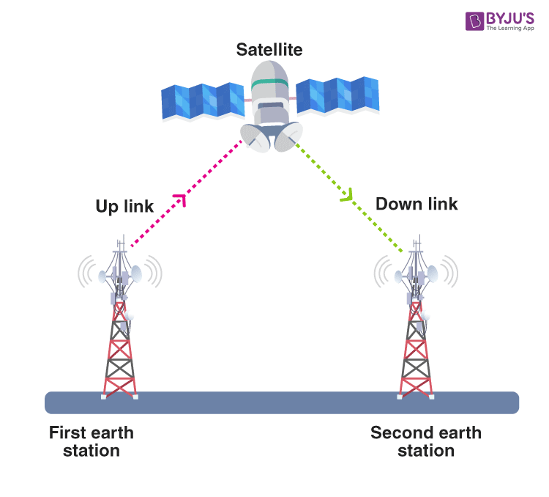

Slide 14
Two-Way Satellite Communication
In two-way satellite communication, the information is exchanged between any two earth stations. It can be said that there is a point to point connectivity.
The signal is transmitted from the first earth station to the second earth station such that there are two uplinks and two downlinks between the earth stations and the satellite.

Slide 15
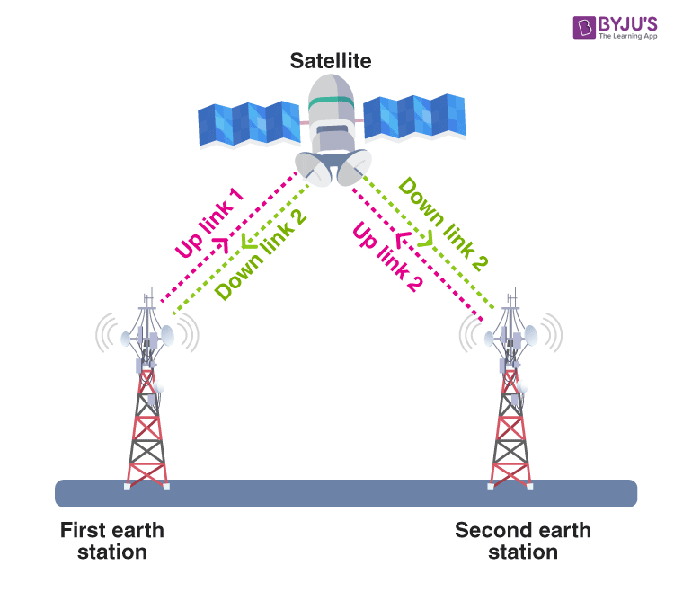

Slide 16
Applications of Satellite Communication :-
1.Telephone
2.Television
3.Digital cinema
4.Radio broadcasting
5.Amateur radio
6.Internet access
7.Military
8.Disaster Management etc……

Slide 17
Advantages of Satellite Communication
The following are the advantages of satellite communication :-
1.Installments of circuits are easy.
2.The elasticity of these circuits is excellent.
3.With the help of satellite communication, every corner of the earth can be covered.
4.The user fully controls the network.

Slide 18
Disadvantages of Satellite Communication :-
The following are the disadvantages of satellite communication:-
1.Initial expenditure is expensive.
2.There are chances of blockage of frequencies.
3.Propagation and interference.

Slide 19
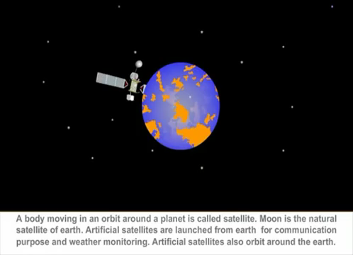

Slide 20


Slide 21
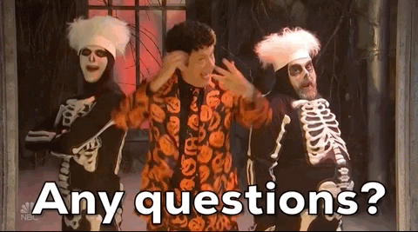

Slide 22


